Slide 1
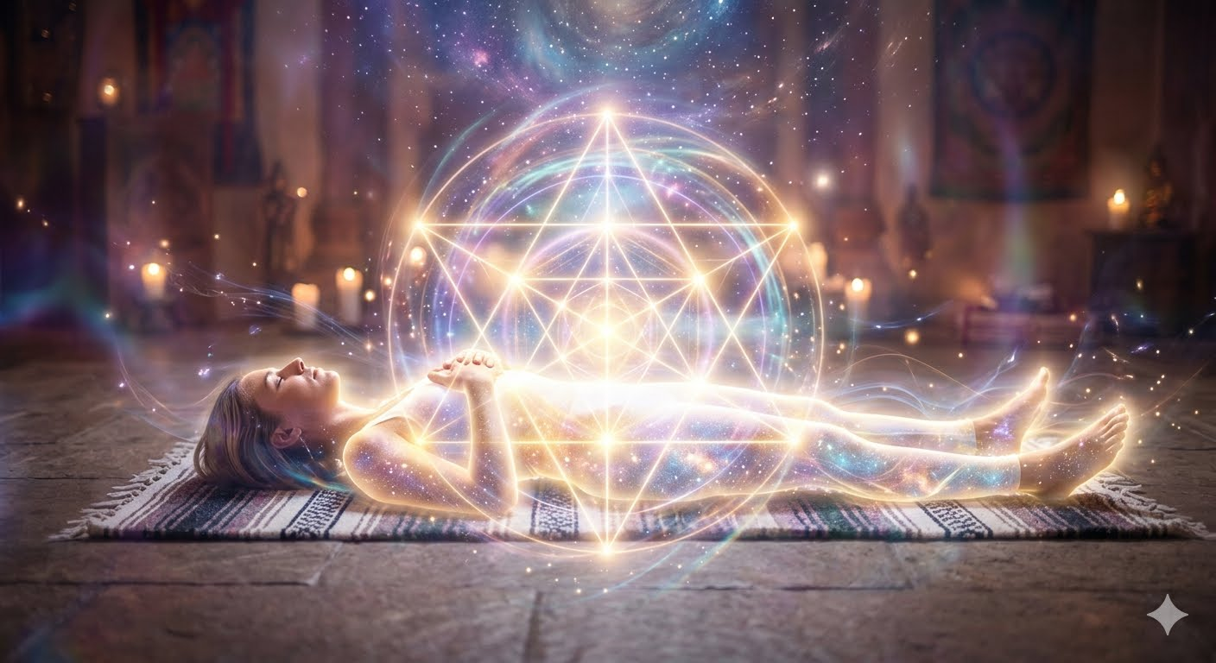
Vehicles of Light: Yoga Nidra through the Lens of Theosophy
An Esoteric Journey into Wakeful Sleep, Sacred Geometry, and Soul Evolution

Slide 2

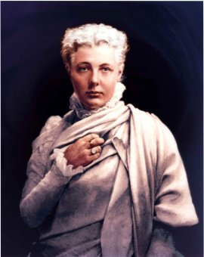

Slide 3
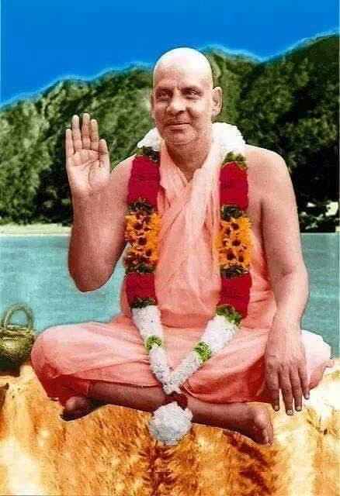
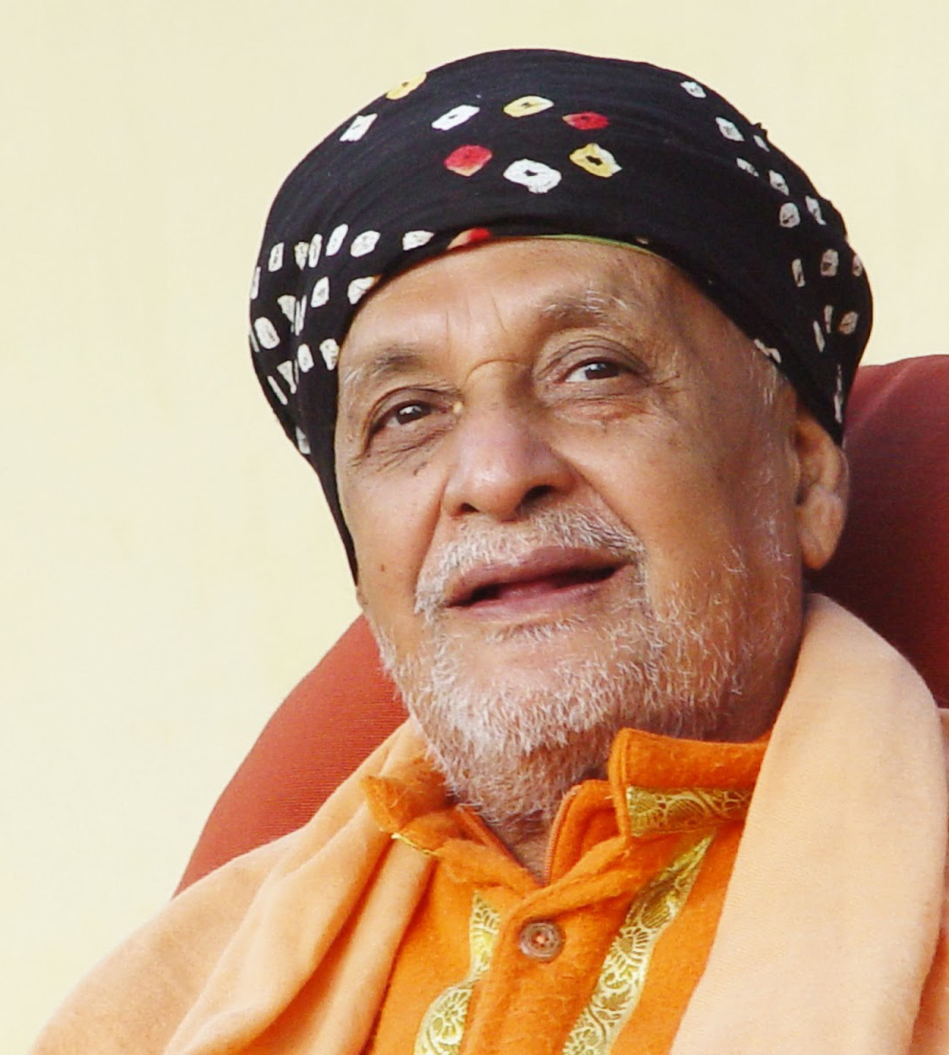
Notes:
25 December 1923 – 5 December 2009 Like HPB's goal of presenting a "synthesis of science, religion and philosophy", Sivananda's philosophy focused on making spiritual and yogic teachings accessible to all. Both emphasized bringing ancient wisdom into the modern era. Sivananda published a major philosophical work titled Unity of Religions (cataloged under ES38 by the Divine Life Society Publication League). While this text outlines the shared essence of all major world traditions, it addresses the core premise of the Theosophical Movement: the synthesis of science, philosophy, and religion to foster a "Universal Brotherhood of Humanity". In this text, Sivananda validates the structural efforts of modern interfaith movements—including the foundational role played by early esoteric and theosophical societies—in breaking down dogmatic barriers between East and West.

Slide 4
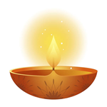
Brief Introduction to Theosophical Cosmology
The Law of Correspondence represented by the Seal of the Theosophical Society.
Mapping the Sevenfold Constitution and the 7 Main Chakras as bridges for the structural vehicles of consciousness and the subtle energy centers of the human body.
Sacred Geometry and Yoga Nidra
States of Consciousness: Framing Yoga Nidra as a method to access the Turiya state, the fourth state of pure consciousness beyond the waking (Jagrat), dreaming (Swapna), and deep sleep (Sushupti) states.

Slide 5
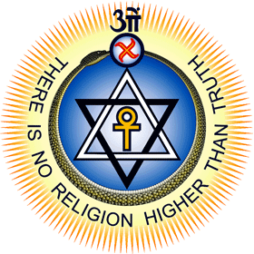
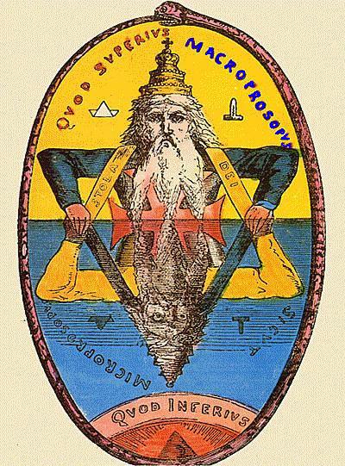
The Law of Correspondence
"As above, so below."
The human being (microcosm) is a perfect mirror of the universe (macrocosm).
Notes:
The official emblem that represents the principle of "as above, so below" in Theosophy is The Seal of the Theosophical Society.The primary representation of this axiom within the seal is the Interlaced Triangles (The Hexagram). The light triangle pointing upward represents the divine spirit, energy, or consciousness reaching upward ("as above"). The dark triangle pointing downward represents matter, manifestation, or physical reality descending ("so below"). Interlocked, they signify that the spiritual and physical worlds are perfect reflections and dependencies of one another. Decoding the Symbols of the SealBeyond the central hexagram, the entire emblem functions as a map of the universe's interconnected layers:The Ouroboros (The Serpent biting its tail): Enclosing the triangles, it represents cyclic eternity, the endless loop of cosmic evolution, and the boundary of the manifested universe.The Ankh: Positioned dead center, this Egyptian cross symbolizes life, consciousness, and the spirit triumphing over or breathing through matter.The Swastika / Whirling Cross: Positioned at the top vertex, it represents the dynamic, fiery energy of creation (Fohat) that spins the static cosmos into active motion.The Om (Aum): Crowned at the very top, this Sanskrit syllable represents the absolute, unmanifested divine sound from which all worlds emerge. Classic Hermetic CounterpartsWhile the interlaced seal is the official theosophical logo, the broader Western esoteric tradition often uses Eliphas Lévi's classic engraving of Solomon's Double Triangle to visually illustrate the "Macroprosopus" (The Great Face/Above) reflecting into the "Microprosopus" (The Lesser Face/Below).

Slide 6
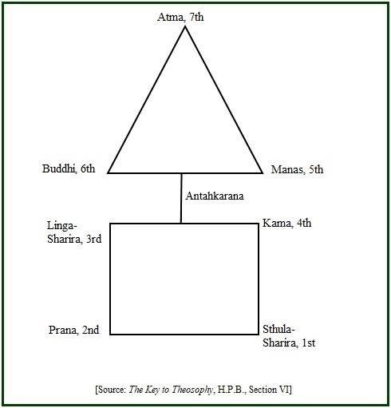
The sacred geometry of a triangle placed over a square represents the union of spirit and matter.
In esoteric symbolism, the 4-sided square represents the material, earthly plane, while the 3-sided triangle (or pyramid) represents the spiritual or celestial realm.
Notes:
II. Identifying The Sevenfold Constitution of Man (The Vehicles of Consciousness)
The Lower Quaternary (The Temporary Personality):
Sthula Sharira: The dense physical body.
Pranamaya Kosha (or Prana): The breath of life / vital energy vehicle.
3. Linga Sharira: The astral double, etheric double, or "model body." It forms the invisible blueprint upon which the physical body is built and cannot exist separate from it.
4. Kama (or Kama-Rupa): The seat of animal desires, passions, and emotions. (When fused with intellect, it operates as Kama-Manas or the lower mind). The Higher Triad (The Immortal Soul/The Reincarnating Ego)
5. Manas: The Higher Mind. The intellectual principle and the vehicle of abstract thought and spiritual ego.
6. Buddhi: The Intuitive Vehicle. The vehicle of pure soul-consciousness, universal love, discernment, and spiritual wisdom.
7. Atman: The Spirit. The highest divine spark, the True Self, which is ultimately one with the universal absolute.

Slide 7
The sacred geometry of a triangle placed over a square represents the union of spirit and matter. In esoteric symbolism, the 4-sided square represents the material, earthly plane, while the 3-sided triangle (or pyramid) represents the spiritual or celestial realm.
Drawing a triangle over a square is a foundational step in the ancient alchemical pursuit of "squaring the circle." By connecting the corners and midpoints of a square to form triangles, the drawing is often enclosed in a circle. This transition from the rigid angles of a square (4-fold) to the infinite curves of a circle (360-degrees) represents the journey from terrestrial bounds to cosmic consciousness.

Slide 8
II. Identifying The Sevenfold Constitution of Man (The Vehicles of Consciousness)
The Lower Quaternary (The Temporary Personality):
Sthula Sharira: The dense physical body.
Pranamaya Kosha (or Prana): The breath of life / vital energy vehicle.
3. Linga Sharira: The astral double, etheric double, or "model body." It forms the invisible blueprint upon which the physical body is built and cannot exist separate from it.
4. Kama (or Kama-Rupa): The seat of animal desires, passions, and emotions. (When fused with intellect, it operates as Kama-Manas or the lower mind).

Slide 9
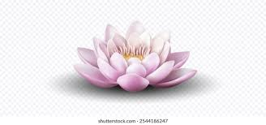
The Higher Triad (The Immortal Soul/The Reincarnating Ego)
5. Manas: The Higher Mind. The intellectual principle and the vehicle of abstract thought and spiritual ego.
6. Buddhi: The Intuitive Vehicle. The vehicle of pure soul-consciousness, universal love, discernment, and spiritual wisdom.
7. Atman: The Spirit. The highest divine spark, the True Self, which is ultimately one with the universal absolute.

Slide 10
The "sacred geometry" of Yoga Nidra refers to the internal mapping of the mind and body.
It involves using yantras (geometric patterns) for visualization and visualizing energy lines connecting points across the body to create a subtle geometry of awareness.
You can explore the geometric principles of Yoga Nidra through three primary dimensions:
The Body Scan (Nyasa): Practitioners systematically move their attention through precise points on the body. By visualizing energy radiating between these points—such as the forehead, throat, heart, and joints—you create an energetic grid or sacred geometry that anchors your focus and harmonizes your nervous system.
The Mind and Koshas: Yoga Nidra guides awareness from the gross physical level inward through the energetic and mental layers (known as the koshas). This progression serves as a geometric descent, moving from the outer circumference of the self into the center of consciousness.
Yantras and Chakras: In deeper, tantric roots of the practice, practitioners visualize internal yantras—mystical diagrams composed of points (bindu), triangles, and circles. These shapes represent specific states of consciousness and the geometry of the chakras (energy centers).

Slide 11
Esoteric Anatomy
Prana and Chakras as Portals
A Theosophical approach views the rotation of consciousness as an internal mapping and balancing the nadis (energy meridians) and the Chakras.
In esoteric anatomy, the physical body is merely the densest crystallization of a complex, multidimensional energetic anatomy.
Through the lens of Theosophy and Eastern Tantra, Prana is the vital currency, and the Chakras are the geometric portals that regulate its flow.

Slide 12
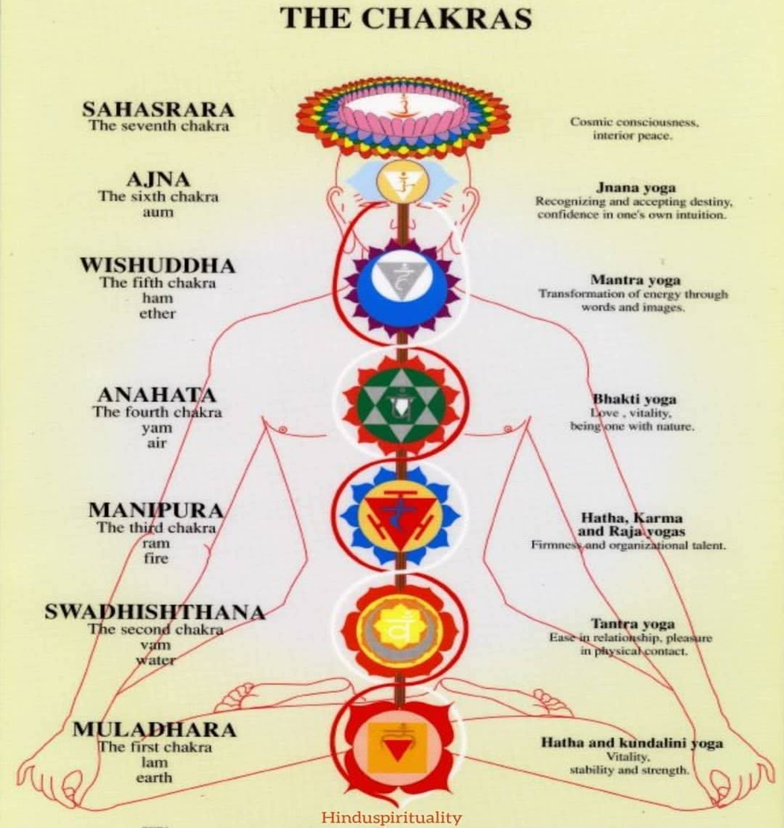
Notes:
Esoteric Anatomy
Prana and Chakras as Portals
A Theosophical approach views the rotation of consciousness as an internal mapping and balancing the nadis (energy meridians) and the Chakras.
In esoteric anatomy, the physical body is merely the densest crystallization of a complex, multidimensional energetic anatomy.
Through the lens of Theosophy and Eastern Tantra, Prana is the vital currency, and the Chakras are the geometric portals that regulate its flow.

Slide 13
Prana: The Cosmic Electrical Grid
Prana is not merely breath; it is the universal life force (Fohat in Theosophy) that bridges consciousness and matter.
The Network: Prana circulates through a complex blueprint of 72,000 Nadis (subtle energy channels).
The Trinity of Flow: The entire system is governed by three primary channels: Ida: The cool, lunar, feminine channel (left side; governs the parasympathetic nervous system).
Pingala: The warm, solar, masculine channel (right side; governs the sympathetic nervous system and physical action).
Sushumna: The central canal running up the spine. It remains dormant until Ida and Pingala are brought into perfect geometric balance, which is the neurological objective of Yoga Nidra.

Slide 14
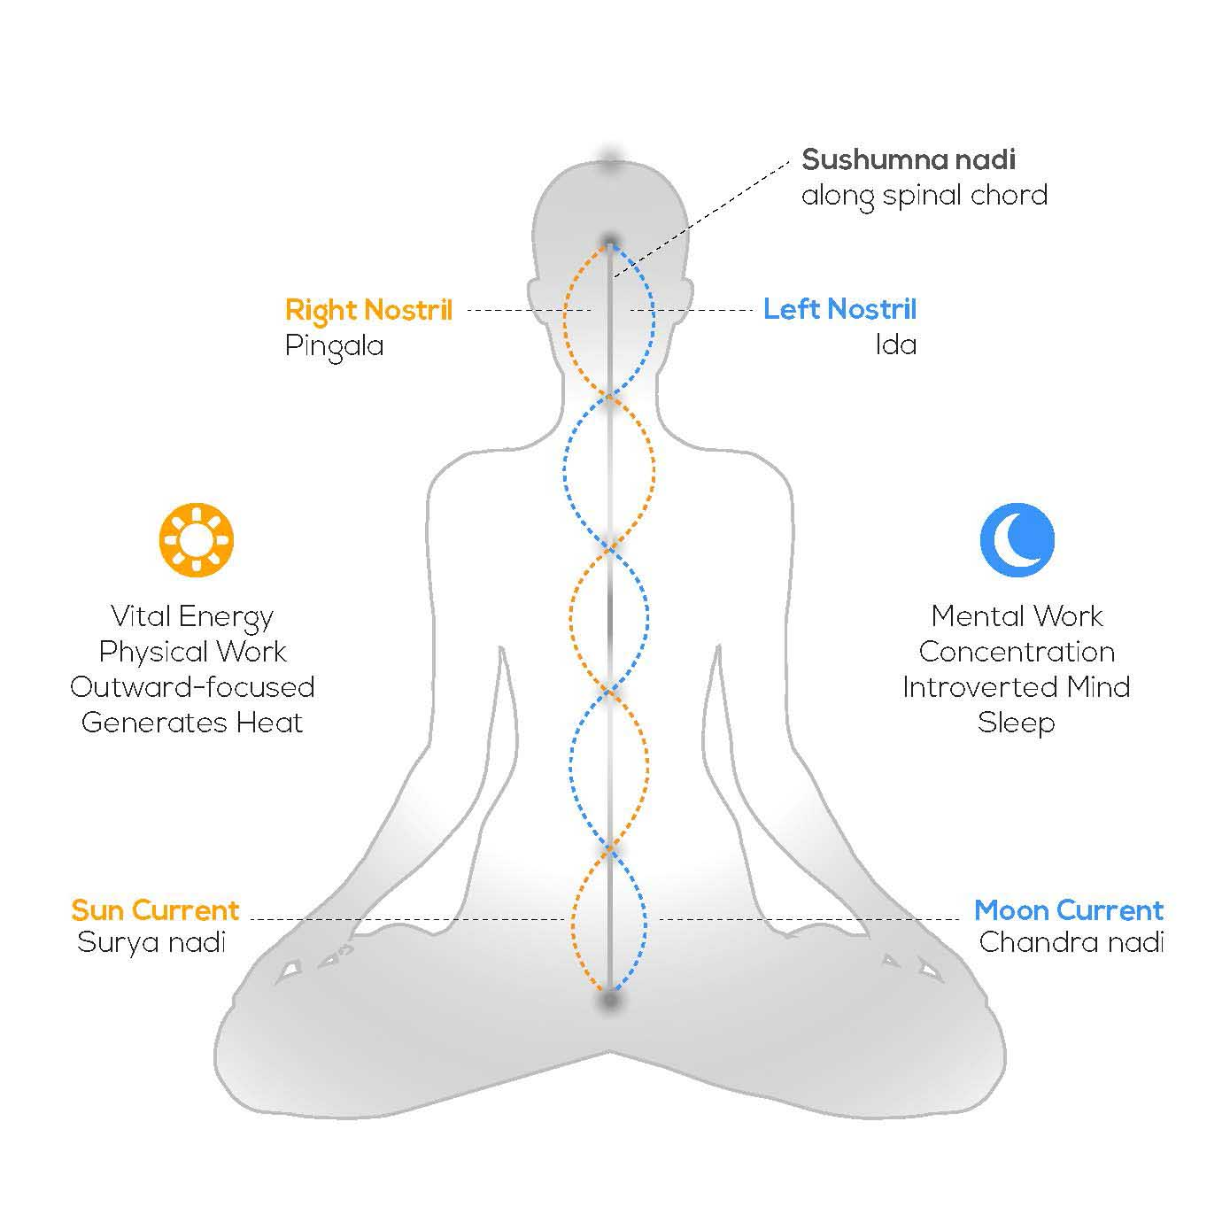
Notes:
According to Nirav Jani of Bharatiya Sanskrit Vidya Kendra, Nadis are the astral tubes made up of astral matter that carry psychic currents. The Sanskrit term ‘Nadi’ comes from the root ‘Nad’ which means ‘motion’. It is through these Nadis (Sukshma, subtle passages), that the vital force or Pranic current moves or flows. Since they are made up of subtle matter they cannot be seen by the naked physical eyes and you cannot make any test-tube experiments in the physical plane. These Yoga Nadis are not the ordinary nerves, arteries and veins that are known to the Vaidya Shastra (Anatomy and Physiology). Yoga Nadis are quite different from these.
The body is filled with innumerable Nadis that cannot be counted. Different authors state the number of Nadis in different ways, i.e., from 72,000 to 3,50,000. When you turn your attention to the internal structure of the body, you are struck with awe and wonder. Because the architect is the Divine Lord Himself who is assisted by skilled engineers and masons—Maya, Prakriti, Visva Karma, etc. Nadis play a vital part in this Yoga. Kundalini when awakened, will pass through Sushumna Nadi and this is possible only when the Nadis are pure. Therefore, the first step in Kundalini Yoga is the purification of Nadis. A detailed knowledge of the Nadis and Chakras, is absolutely essential. Their location, functions, nature, etc., should be thoroughly studied.
The subtle lines, Yoga Nadis, have influence in the physical body. All the subtle (Sukshma) Prana, Nadis and Chakras have gross manifestation and operation in the physical body. The gross nerves and plexuses have close relationship with the subtle ones. You should understand this point well. Since the physical centres have close relationship with the astral centres, the vibrations that are produced in the physical centres by prescribed methods, have the desired effects in the astral centres.
Whenever there is an interlacing of several nerves, arteries and veins, that centre is called “Plexus.” The physical material plexuses that are known to the Vaidya Shastra are:— Pampiniform, Cervical, Brachial, Coccygeal, Lumbar, Sacral, Cardiac, Esophageal, Hepatic Pharyngeal, Pulmonary, Ligual Prostatic Plexus, etc. Similarly there are plexuses or centres of vital forces in the Sukshma Nadis. They are known as ‘Padma’ (lotus) or Chakras. Detailed instructions on all these centres are given elsewhere. All the Nadis spring from the Kanda. It is in the junction where the Sushumna Nadi is connected with the Muladhara Chakra. Some say, that this Kanda is 12 inches above the anus. Out of the innumerable Nadis 14 are said to be important. They are:—
1. Sushumna
2. Ida
3. Pingala
4. Gandhari
5. Hastajihva
6. Kuhu
7. Saraswati
8. Pusha
9. Sankhini
10. Payasvini
11. Varuni
12. Alambusha
13. Vishvodhara
14. Yasasvini

Slide 15
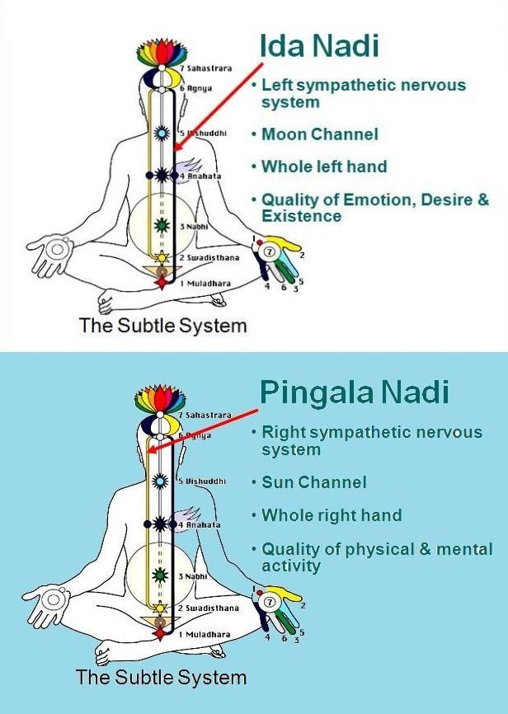

Slide 16
The Interdimensional Funnel:
Each chakra functions like a double-coned vortex. The wide mouth of the funnel opens into the Astral and Mental planes, while the narrow tip roots directly into the Etheric Double and physical endocrine system.
Step-Down Transformers:
The spiritual energies of the Upper Triad are blindingly high frequency. If they hit the physical brain directly, they would damage the nervous system. The chakras act as step-down transformers, slowing down spiritual light into a safe, usable voltage (Prana) for the physical body.
Geometric Filters:
Each chakra is encoded with a specific geometric archetype (Yantra). When a chakra is misaligned, its geometric rotation becomes distorted, causing physical disease or emotional stagnation.

Slide 17
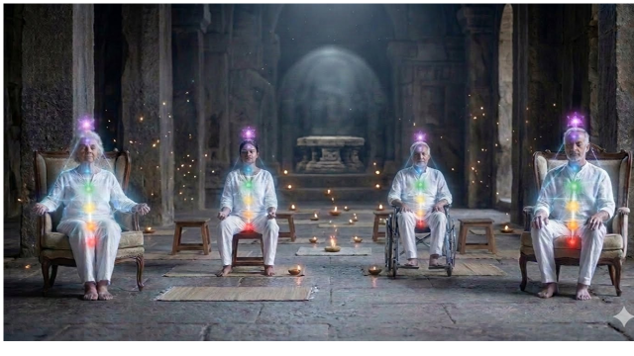
Notes:
III. The Portal Mechanics in Yoga Nidra
During the immersion, the guide acts as an engineer working on this esoteric machinery:
De-energizing the Outlets: By immobilizing the physical body, the energy that normally flows out of the chakras to run the physical senses is pulled inward.
Opening the Gates: As your consciousness moves through the body points, it acts like a key turning in a lock, clearing the debris from the chakra funnels.
The Portal Shift: Once the lower vehicles are quieted, the chakras cease acting as step-down transformers. Instead, they reverse their function and become step-up portals. They open wide, allowing the practitioner's waking awareness to stream upward out of the material square and directly into the spiritual triad (Turiya).

Slide 18
III. The Portal Mechanics in Yoga Nidra
During the immersion, the guide acts as an engineer working on this esoteric machinery:
De-energizing the Outlets: By immobilizing the physical body, the energy that normally flows out of the chakras to run the physical senses is pulled inward.
Opening the Gates: As your consciousness moves through the body points, it acts like a key turning in a lock, clearing the debris from the chakra funnels.
The Portal Shift: Once the lower vehicles are quieted, the chakras cease acting as step-down transformers. Instead, they reverse their function and become step-up portals. They open wide, allowing the practitioner's waking awareness to stream upward out of the material square and directly into the spiritual triad (Turiya).

Slide 19
Root Chakra (Muladhara) ↔ Sthula Sharira (The Dense Physical Body)
The Connection: The Root Chakra is located at the base of the spine and is tied to the element of Earth.
The Function: It anchors your consciousness into the solid, physical world. It governs survival, physical structures (bones, teeth, immune system), and the dense physical vehicle (Sthula Sharira). It is the foundation that keeps the physical body rooted to the planetary ecosystem.
The canonical symbol for the Muladhara (Root) Chakra is a deep red lotus with four petals, containing a yellow square at its center and an inverted triangle.

Slide 20
In traditional Vedic and Tantric iconography, every piece of the Muladhara mandala carries a specific geometric meaning:
The Four Petals: Represent the four states of consciousness or mind (Chitta, Buddhi, Manas, and Ahamkara) or the four directions of physical space.
Each petal is inscribed with a specific Sanskrit seed letter (Va, Scha, Sha, Sa).The Yellow Square: Represents the Earth element (Prithvi), signifying stability, structure, grounding, and the physical material world.
The Inverted Triangle: Symbolizes the downward flow of spirit into matter, and acts as the seat of the dormant Kundalini energy coiled at the base of the spine.
The Seed Syllable (Bija Mantra): Written in the absolute center of the square is the Sanskrit character LAM (लं), which is the foundational sound frequency of the earth element.
Color: Red

Slide 21
Sacral Chakra (Svadhisthana) ↔ Pranamaya Kosha (The Vital Energy / Prana)
The Connection: Located in the lower abdomen, this chakra is tied to the element of Water, movement, and vitality.
The Function: The Sacral Chakra regulates the flow of vitality throughout the body. It processes raw Prana (life-force energy), distributing it to the physical organs to fuel vitality, reproduction, fluid balance, and physical stamina.
Color: Orange

Slide 22
The canonical symbol for the Svadhisthana (Sacral) Chakra is a vibrant orange lotus with six petals, containing a white crescent moon nestled inside a larger circle at its center.
In traditional Tantric and Vedic iconography, each geometric component of the Svadhisthana mandala represents a specific cosmic force:
The Six Petals: Represent the six negative mental traits or modifications of the mind (Vrittis) that must be purified at this level: anger, jealousy, pride, cruelty, hatred, and desire.
Each petal is inscribed with a specific Sanskrit seed letter (Bam, Bham, Mam, Yam, Ram, Lam).The White Crescent Moon: Represents the Water element (Apas).
It symbolizes the fluid nature of energy, emotions, adaptability, and the lunar forces that govern tides, cycles, and creativity.
The Concentric Circles: The moon sits inside a larger circle, which represents the cyclic nature of birth, death, renewal, and the subconscious mind.
The Seed Syllable (Bija Mantra): Positioned at the very center of the crescent moon is the Sanskrit character VAM (वं), which is the sound frequency that corresponds to the water element and fluid vitality.

Slide 23
Solar Plexus Chakra (Manipura) ↔ Kama (The Desire Body / Astral Body)
The Connection: Located at the navel center, this chakra is tied to Fire.
The Function: In subtle anatomy, the Solar Plexus is the emotional clearinghouse. It maps directly to Kama, the seat of raw passions, desires, ego-drive, anger, and personal power. When you experience a strong emotional reaction, you physically feel it as a knot or flutter in your solar plexus because your emotional vehicle is vibrating through this specific center.
Color: Yellow

Slide 24
The canonical symbol for the Manipura (Solar Plexus) Chakra is a bright yellow lotus with ten petals, containing a large inverted red triangle at its center.
In traditional Tantric and Vedic iconography, each geometric component of the Manipura mandala represents a specific cosmic force:
The Ten Petals: Represent the ten vital currents or energies (Pranas) that regulate bodily functions, or the ten mental modifications (Vrittis) to be mastered: spiritual ignorance, thirst, jealousy, treachery, shame, fear, disgust, delusion, foolishness, and sadness.
Each petal is inscribed with a specific Sanskrit seed letter (Dam, Dham, Nnam, Tam, Tham, Dam, Dham, Nam, Pam, Pham).The Inverted Red Triangle: Represents the Fire element (Agni).
The triangle points downward to show the descent of energy into the engine of the body, symbolizing digestion, heat, metabolism, and the transformative power of fire.
The T-Shaped Swastikas: On each outer side of the central triangle, there are often three T-shaped markings representing the traditional Vedic fire hearths or arms of fire.
The Seed Syllable (Bija Mantra): Positioned at the absolute center of the triangle is the Sanskrit character RAM (रं), which is the sound frequency that corresponds to fire, personal will, and metabolic energy.

Slide 25
Heart Chakra (Anahata) ↔ Linga Sharira (The Astral Double / Bridge)
The Connection: Located in the center of the chest, representing Air.
The Function: The Heart Chakra serves as the central axis of the entire chakra system, dividing the lower physical centers from the higher spiritual centers. It aligns with the Linga Sharira because it acts as the ultimate mediator. Just as the Linga Sharira bridges the unseen blueprint to physical manifestation, the Heart Chakra bridges animal desire (Kama) into higher spiritual devotion, translating cosmic energies into human biology.
Color: Green

Slide 26
The canonical symbol for the Anahata (Heart) Chakra is a soft green lotus with twelve petals, containing a central hexagram (six-pointed star) formed by two intersecting triangles.
The Twelve Petals: Represent the twelve divine qualities or virtues of the heart: joy, peace, love, harmony, bliss, clarity, compassion, purity, understanding, forgiveness, tolerance, and empathy.
Each petal is inscribed with a specific Sanskrit seed letter (Kam, Kham, Gam, Gham, Ngam, Cham, Chham, Jam, Jham, Nyam, Tam, Tham).The Intersecting Triangles (Hexagram): Represents the Air element (Vayu) and the union of opposites. The upward-pointing triangle symbolizes Shiva (the masculine, spiritual consciousness), while the downward-pointing triangle symbolizes Shakti (the feminine, material manifestation).
Their intersection represents perfect balance.The Smoke-Gray Color: The central region is often depicted in a smoke-gray color, representing the elusive, dynamic, and non-physical nature of air and breath.The Seed Syllable (Bija Mantra): Positioned at the absolute center of the star is the Sanskrit character YAM (यं), which is the sound frequency that corresponds to the air element, love, and the bridge between the lower and higher worlds.

Slide 27
Throat Chakra (Vishuddha) ↔ Manas (The Higher/Lower Mind)
The Connection: Located at the throat, representing Ether or Space.
The Function: The Throat Chakra is the center of expression, communication, and creative intellect. It maps to Manas (Mind). It is through this center that abstract thought, conceptualization, and mental blueprints are organized and spoken into physical existence. It governs the transition from feeling an emotion to logically structuring it into words.
Color: Blue

Slide 28
The canonical symbol for the Vishuddha (Throat) Chakra is a smoke-colored or sky-blue lotus with sixteen petals, containing a downward-pointing triangle that encloses a full moon or a pure white circle.
The Sixteen Petals: Represent the sixteen Sanskrit vowels (Am, Aam, Im, Eem, Um, Oom, Rm, Rrm, Lm, Lrm, Em, Aim, Om, Aum, Am, Ah). In Sanskrit, vowels are considered the "spirit" or life-force of language, whereas consonants are the "matter.“
The Pure White Circle (or Full Moon): Represents the Akasha or Ether/Space element. It signifies absolute purity, spaciousness, emptiness, and the cosmic field through which sound frequencies travel.
The Downward-Pointing Triangle: Contains the white circle and represents the channel of manifestation. It shows that higher spiritual truths are being stepped down and translated into human speech and creative expression.
The Seed Syllable (Bija Mantra): Positioned at the absolute center of the circle is the Sanskrit character HAM (हं), which is the sound frequency that corresponds to the space element, communication, and intellectual resonance.

Slide 29
Third Eye Chakra (Ajna) ↔ Buddhi (The Intuitive Vehicle)
The Connection: Located between the eyebrows, representing Light and cosmic mind.
The Function: The Third Eye is the seat of higher vision, insight, and direct knowing. It bypasses the logical processing of the throat chakra to tap directly into Buddhi (Spiritual Wisdom/Intuition). When this center is active, a person experiences reality through holistic synthesis and unity consciousness rather than fragmented intellectual analysis.
Color: Indigo

Slide 30
The canonical symbol for the Ajna (Third Eye) Chakra is an indigo or deep blue lotus with only two petals, containing an inverted triangle and a white circle or crescent moon at its center. In traditional Tantric and Vedic iconography, the minimal geometry of the Ajna mandala represents the transcending of worldly duality:
The Two Petals: Represent the ultimate duality of existence—manifest and unmanifest, spirit and matter, or the two main psychic channels (Ida and Pingala nadis) that cross at this point. They are inscribed with the Sanskrit letters Ham and Ksham.
The Inverted Triangle: Symbolizes the downward pouring of divine wisdom and cosmic light into human intuition. It acts as the portal to higher planes of consciousness.
The Inner White Circle: Represents the elemental form of the mind (Manas), which has now been purified to reflect cosmic reality clearly, like a still lake reflecting the moon.
The Seed Syllable (Bija Mantra): Positioned at the exact center is the sacred Sanskrit syllable OM (ॐ), representing the primordial sound of creation and the unified field of absolute truth.

Slide 31
The canonical symbol for the Sahasrara (Crown) Chakra is a brilliant violet or pure white lotus with one thousand petals, arranged in multiple concentric layers around a central, glowing void or a radiant golden disk.
In traditional Tantric and Vedic iconography, the complex geometry of the Sahasrara mandala signifies the transcendence of all elements and the achievement of complete spiritual liberation:
The One Thousand Petals: Represent infinite consciousness, absolute perfection, and the total expansion of energy. In the subtle body, it symbolizes the completion of the spiritual journey where all individual energy pathways (Nadis) culminate.
The Central Void / Golden Disk: Unlike the lower six chakras, Sahasrara contains no elemental symbol (like earth, water, or fire) and no standard geometric shapes. The center is a radiant void, representing Paramatman, the supreme, unmanifested reality that exists beyond time, space, and physical attributes.
The Transcendental Sound: While some traditions associate it with the silent vibration of OM (ॐ), the ultimate state of Sahasrara is defined by Anahata Dhvani—the uncommitted, silent sound of the universe itself. It represents the point where the individual soul (Atman) dissolves back into the universal whole (Brahman).

Slide 32
Crown Chakra (Sahasrara) ↔ Atman (The Divine Spirit / True Self)
The Connection: Located at the top of the head, representing Pure Consciousness.
The Function: The thousand-petaled lotus is the exit and entry point for the divine spark. It maps directly to Atman, the immortal, unchanging spirit. It does not process worldly information or personal emotions; instead, it connects the localized individual consciousness directly to the universal, absolute whole (Brahman).
Color: Violet

Slide 33
How Yoga Nidra Works
Yoga Nidra shifts awareness from the dense Sthula Sharira into the Sukshma Sharira through a highly structured path:
1. Anchoring and Quieting the Physical Frame (Annamaya Kosha) The objective is to immobolize the physical body (Sthula Sharira). You are guided through a rapid rotation of consciousness across individual body parts (e.g., thumb, fingers, palm). This continuous movement keeps the brain awake while systematically exhausting its motor cortex, breaking your focus away from physical form
In the original Tantric system, the precursor practices to modern Yoga Nidra, collectively known as Nyasa, were traditionally performed in a seated meditation posture such as Padmasana (Lotus Pose) or Siddhasana (Accomplished Pose)

Slide 34
2. Shifting to Vital Energy (Pranamaya Kosha)
Once physical sensations fade, instructions shift to breath awareness and energy tracking.
By observing the natural flow, length, and rhythm of the breath, you bridge the gap between physical matter and energy.
This redirects awareness into the vital or etheric body, balancing the autonomic nervous system and harmonizing life-force energy (prana).

Slide 35
3. Calming the Lower Mind (Manomaya Kosha)
Awareness next enters the lower mind (Manas), which governs everyday emotions and sensory processing.
Yoga Nidra systematically detaches you from this layer by prompting you to evoke opposite sensations (such as extreme heat and cold, or intense heaviness and lightness).
Experiencing these polar opposites neutralizes your automatic emotional reactions, quieting the restless chatter of the mind.

Slide 36
4. Accessing Wisdom and Bliss (Vijnanamaya & Anandamaya Koshas)
With the lower mind quieted, consciousness deepens into the higher mind (Vijnanamaya Kosha), the realm of wisdom and insight.
Rapid-fire symbolic visualizations are introduced to engage the subconscious.
Finally, awareness touches the causal body via the Anandamaya Kosha (the bliss sheath).
Here, you rest in a state of deep, conscious dreamless sleep—retaining full awareness while experiencing profound peace.

Slide 37
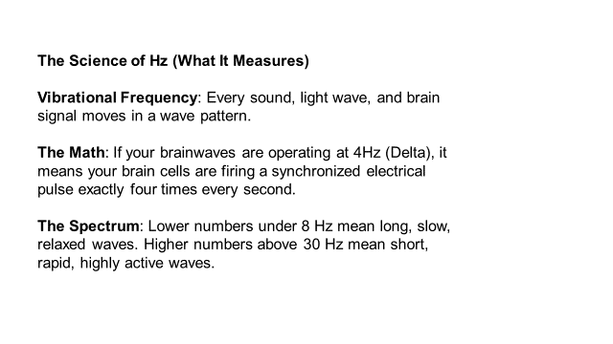
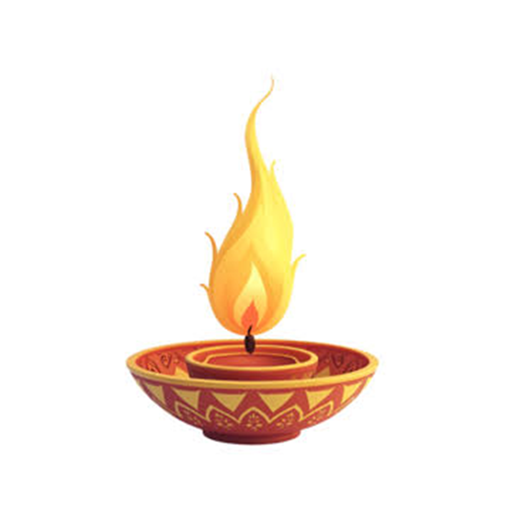

Slide 38
Frequencies as "Spiritual Tuning“
Just like tuning a radio to a specific Hz channel allows you to hear a clear broadcast, shifting your brainwaves to specific frequencies allows you to access different realms of consciousness.

Slide 39
Hertz (Hz) is the scientific unit of measurement for frequency, representing the number of times a wave cycles or vibrates per second (1Hz = 1 cycle/second.
In Neuroscience, it measures how fast neurons fire electrical signals.
In Acoustics, it measures sound pitch; and in Physics, it measures the electromagnetic spectrum.
Spiritually, Hz represents the rate of your energetic vibration, indicating that your consciousness is not static, but a dynamic field of energy that fluctuates based on your thoughts, emotions, and meditative focus.

Slide 40
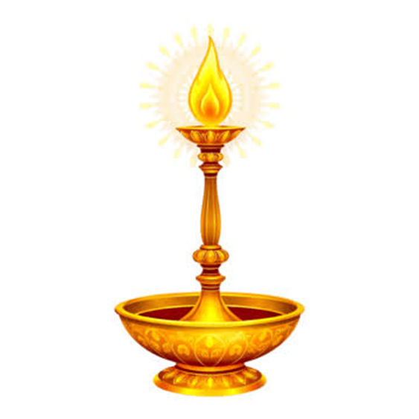
The Spiritual Meaning of Hz
In Esoteric traditions, Eastern philosophy, and modern metaphysics, everything in the universe is understood to be in a constant state of vibration (the Hermetic Principle of Vibration).
This physical reality translates to spiritual evolution through specific energetic shifts:
[0.5 Hz — Delta] ───────────────────► [40 Hz — Gamma]
The Slowest/Dense Density and Total Ego Dissolution to the Highest/Luminous Clarity and Unified Cosmic Consciousness

Slide 41
Distinguishing Turiya From Other States
Practitioners often mistake deep physical relaxation or sleep for Turiya.
How the brainwave and experiential states differ during a session:
Described by State, Level of Consciousness, Brainwave Activity and Experience
1. Waking State. Level of Consciousness: (Jagrat) Brainwave Activity: Alpha (8 – 12 Hz): Experience: Quiet, awake relaxation and calm, reflective mental states.
Beta (12 – 30 Hz): Active thinking, analytical problem-solving, and focused external attention.
2. Dreaming State. Level of Consciousness: (Svapna) Brainwave Activity: Theta (4 – 8 Hz) Experience: Deep relaxation, dreaming (REM sleep), and vivid internal visualization.
3. Deep Sleep State. (Sushupti) Brainwave Activity: Delta (0.5 – 4 Hz) Experience: Deep, dreamless sleep and total physical unconsciousness.
4. The Fourth State. (Turiya) Brainwave Activity: Gamma Shift is a sudden, high-frequency brainwave burst (30–100 Hz) that acts as a neural binding mechanism, synchronizing distant regions of the brain to produce a state of unified hyper-awareness, profound mental integration, and transcendental insight.

Slide 42
1. Low Frequencies 0.5 – 8 Hz: Dissolution and The Void
Spiritually, slow frequencies like Delta and Theta represent returning to the Source. When your brain waves drop to these levels while remaining conscious (as in Yoga Nidra), your physical ego-identity dissolves. You enter the unmanifested "Void," the womb of consciousness where individual separation ceases, allowing for profound mystical surrender and deep soul healing.
2. Mid Frequencies 8 – 12 Hz: The Bridge of Presence
Alpha frequencies act as the energetic bridge between worlds. It is the state of pristine, present-moment awareness. Spiritually, it represents alignment, mindfulness, and the transition from looking outward at the material world (Maya) to looking inward at the true Self (Atman).
3. High Frequencies 30 - 100Hz: Spiritual Evolution and Ascension
A Gamma Shift is the neurological equivalent of Spiritual Awakening or Samadhi. Because Gamma waves require different parts of the brain to fire in perfect, harmonious unison, it represents the dissolution of duality. On a spiritual level, high-amplitude Gamma activity is the signature of cosmic consciousness, absolute divine love, and flashes of sudden, transcendent enlightenment.

Slide 43
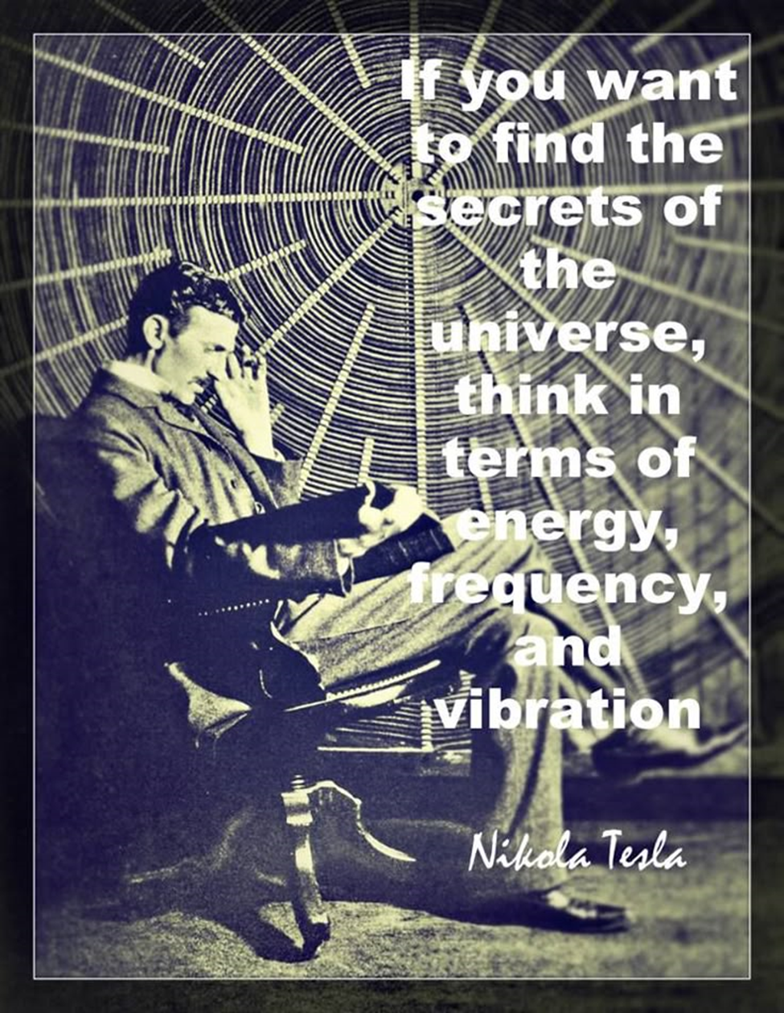
What is the relationship between Frequency, Vibration and Light?
The core relationship is that vibration is the physical movement, frequency is the speed of that movement, and light is the visible reality created when that frequency becomes incredibly high.
In Physics, they are different aspects of the exact same energy.
Spiritually, they form the blueprint of how pure energy condenses into physical matter.

Slide 44
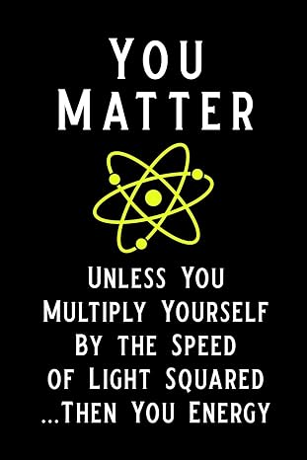

Slide 45
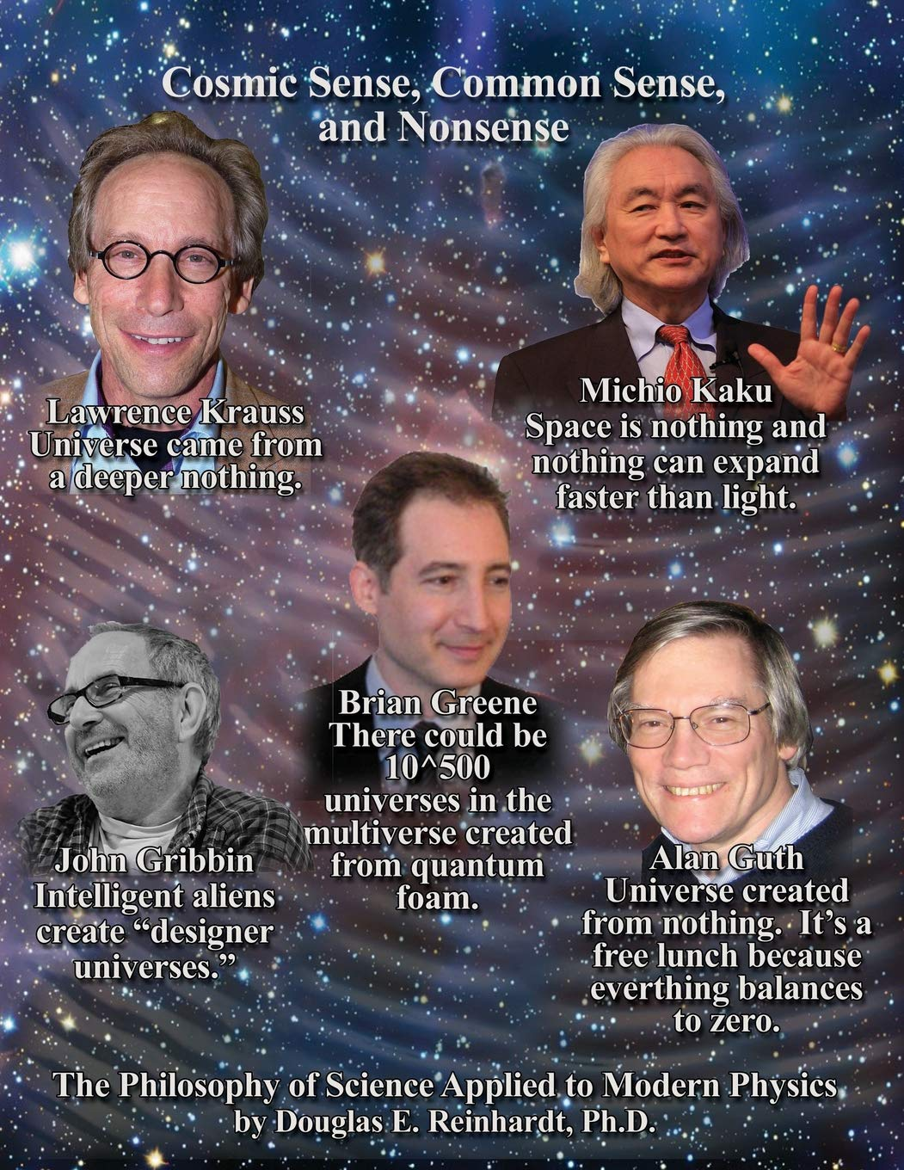
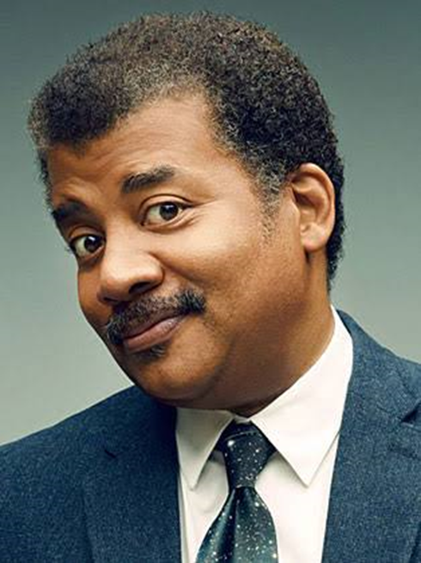
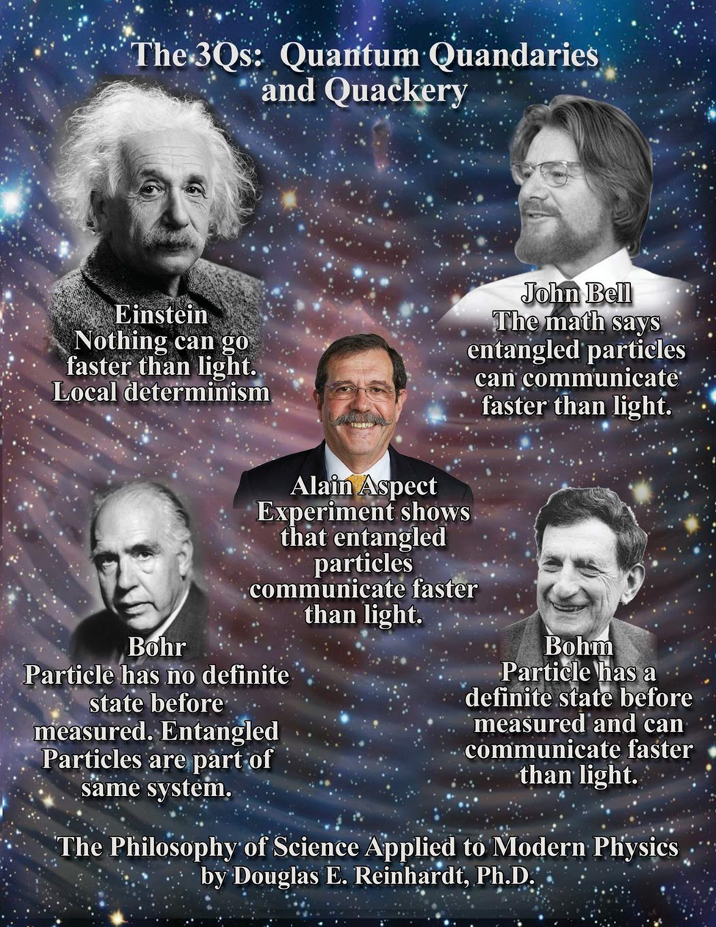

Slide 46
The Scientific Relationship
The absolute, formulaic relationship between these three elements is governed by the laws of electromagnetism:
Vibration is the Source: Light is an electromagnetic wave. These waves are born when charged particles (electrons) physically vibrate back and forth.
Frequency is the Measurement: As those particles vibrate, they send out ripples through space. Frequency (measured in Hertz) counts how many times those ripples crest and trough in one single second.
Light is the Result: When physical vibration speeds up to a staggering 430 trillion to 770 trillion Hertz, it enters the "visible spectrum." At this incredibly high frequency, the energy manifests as visible light and color.
The mathematical relationship is absolute: c = f lambda. The speed of light (c) equals frequency (f\) multiplied by wavelength (lambda). Because the speed of light is a constant, higher frequencies always create shorter, more energetic waves.

Slide 47
The Spiritual Relationship
Spiritually, this triad explains the cosmic law of manifestation. Famously summarized by Nikola Tesla: "If you want to find the secrets of the universe, think in terms of energy, frequency and vibration."
[ PURE SPIRIT ] ──► High Frequency / Fast Vibration ──► Luminous Light │ ▼ (Slowing down)
[ FIXED MATTER ] ──► Low Frequency / Slow Vibration ──► Solid Physicality

Slide 48
1. Vibration is the State of Being
Every object, thought, and living being has a "vibrational signature." It is the oscillating movement of your personal life-force energy (Prana or Qi). Dense, heavy emotions like fear and anger vibrate slowly. Expansive, joyful emotions like love and peace vibrate rapidly.
2. Frequency is the Dial of Realities
Frequency determines what you are capable of experiencing or channeling. Just as your brainwave frequency determines whether you are awake or experiencing the cosmic state of Turiya, your overall energetic frequency dictates your spiritual resonance. It acts as a tuning fork, drawing matching external experiences toward you.
3. Light is the Ultimate Realization
In almost every mystical tradition, God, Source, or ultimate consciousness is described as Pure Light. Spiritually, Light is what happens when matter vibrates so fast that it sheds its density and returns to its purest form. When you "raise your vibration," you increase your frequency, transforming dense, physical ego-awareness back into luminous, unified spiritual light.

Slide 49
The Witness Consciousness
The Atman (the Higher Self) as the eternal observer, detached from the transient illusions (Maya) of the physical world.

Slide 50
Practical Theosophical Yoga Nidra (30 minutes)
A guided, extended meditation session tailored to these esoteric concepts:
Pratyahara (Sense Withdrawal): The conscious, deliberate detachment from physical surroundings to turn inward.
The Sankalpa (Vow/Intention): Framing the resolve as a direct command from the Higher Self, meant to impress spiritual truth into the subconscious rather than manifest material desires.
Visualization of Cosmic Symbols: Guiding the mind toward abstract, geometric, or archetypal imagery (like the lotus or cosmic ocean) to stimulate the Ajna chakra (the third eye).

Slide 51

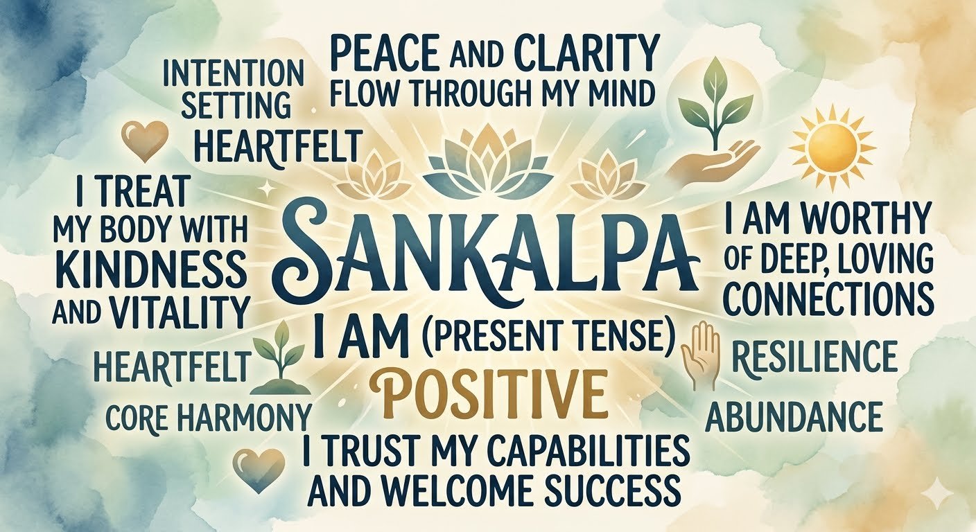

Slide 52
Refined Sankalpa (Intention) Options
In Theosophy, a Sankalpa is not for material gains or ego desires. It is a direct command from the Higher Self (Atman) to align the lower mind.
Choose or adapt one of these formulas:
For Spiritual Awakening: "I am aligned with my Higher Self, and my lower vehicles are perfect instruments of Divine Will.“
For Cosmic Integration: "I step beyond the illusion of separateness to realize my oneness with the All.“
For Evolutionary Service: "I awaken my spiritual intuition to serve the evolution of all living beings."

Slide 53
How does a theosophical Sankalpa differ from modern manifestation' or the Law of Attraction?
Modern manifestation often focuses on the desires of the lower astral body (Kama Manas)—like a new car or a specific relationship.
A theosophical Sankalpa bypasses ego desires entirely. It is a directive from the immortal triad to align your personality with divine service and evolution.

Slide 54
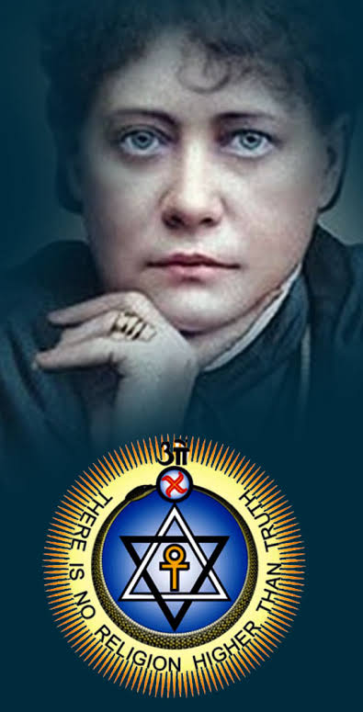

Slide 55


